Slide 1


Rafael Paz Silva
05/01/2022
https://github.com/rafapaz/ML_IBM-10

Slide 2

Outline
Executive Summary
Introduction
Methodology
Results
Conclusion
Appendix
<number>
Notes:
<number>

Slide 3
Executive Summary
Summary of methodologies
Collecting the data
Web scraping
Data wrangling
EDA for data visualization
EDA with SQL
Map Analysis with Folium
Dashboard with Plotly Dash
Machine Learning Prediction
Summary of all results
Exploratory data analysis results
Interactive analytics demo in screenshots
Predictive analysis results
2

Slide 4
Introduction
Project background and context
We predicted if the Falcon 9 first stage will land successfully. SpaceX advertises Falcon 9 rocket launches on its website, with a cost of 62 million dollars; other providers cost upward of 165 million dollars each, much of the savings is because SpaceX can reuse the first stage. Therefore, if we can determine if the first stage will land, we can determine the cost of a launch. This information can be used if an alternate company wants to bid against SpaceX for a rocket launch.
Problems you want to find answers
What influences if the rocket will land successfully?
The effect each relationship with certain rocket variables will impact in determining the success rate of a successful landing.
What conditions does SpaceX have to achieve to get the best results and ensure the best rocket success landing rate.
3

Slide 5

4

Slide 6
Methodology
Data collection methodology:
SpaceX Rest API
(Web Scrapping) from Wikipedia
Performed data wrangling (Transforming data for Machine Learning)
One Hot Encoding data fields for Machine Learning and dropping irrelevant columns
Performed exploratory data analysis (EDA) using visualization and SQL
Plotting : Scatter Graphs, Bar Graphs to show relationships between variables to show patterns of data.
• Performed interactive visual analytics using Folium and Plotly Dash
• Performed predictive analysis using classification models
How to build, tune, evaluate classification models
4
Notes:
<number>

Slide 7
Data Collection
• We worked with SpaceX launch data that is gathered from the SpaceX REST API.
• This API will give us data about launches, including information about the rocket used,
payload delivered, launch specifications, landing specifications, and landing outcome.
• Our goal is to use this data to predict whether SpaceX will attempt to land a rocket or not.
• The SpaceX REST API endpoints, or URL, starts with api.spacexdata.com/v4/.
• Another popular data source for obtaining Falcon 9 Launch data is web scraping Wikipedia using BeautifulSoup.
6

Slide 8
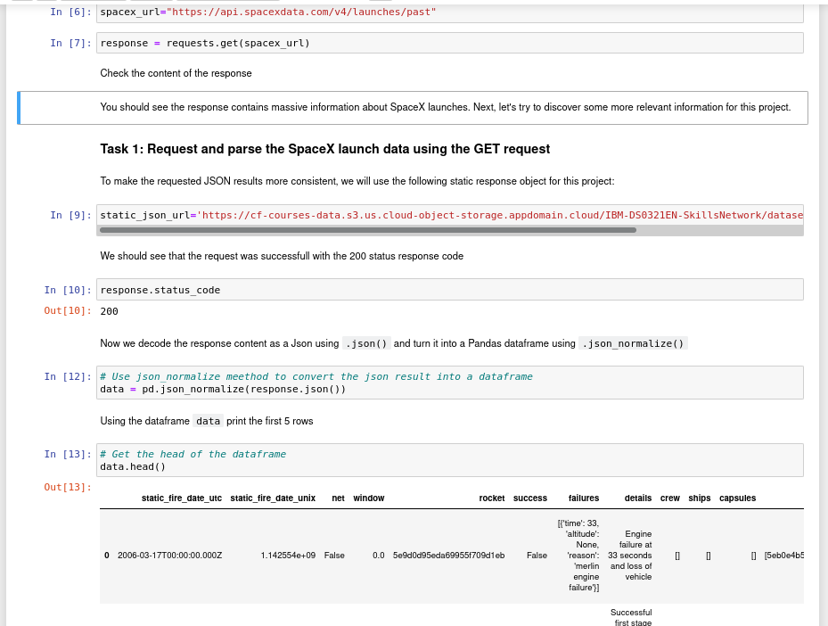
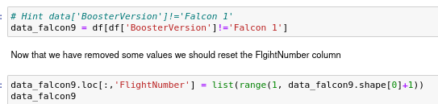
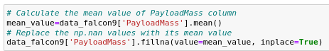
Data Collection – SpaceX API
Request and parse the SpaceX launch data using the GET request
Filter the dataframe to only include Falcon 9 launches
Dealing with Missing Values
7
Github URL: https://github.com/rafapaz/ML_IBM-10/blob/master/jupyter-labs-spacex-data-collection-api.ipynb

Slide 9
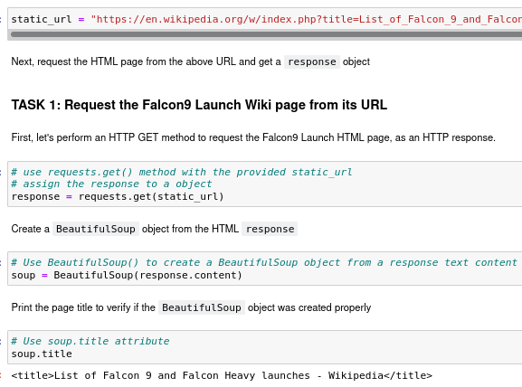
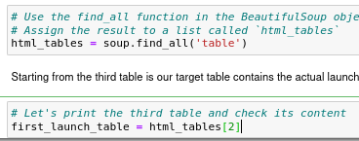
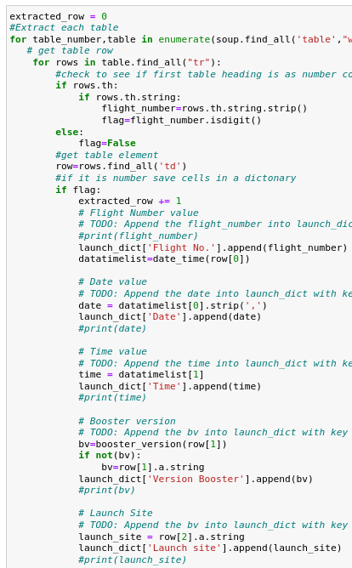
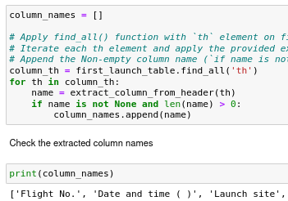
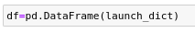
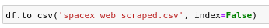
Data Collection - Scraping
Request the Falcon9 Launch Wiki page from its URL
Extract all column/variable names from the HTML table header
Create a data frame by parsing the launch HTML tables
Save csv:
8
Github URL: https://github.com/rafapaz/ML_IBM-10/blob/master/jupyter-labs-webscraping.ipynb

Slide 10
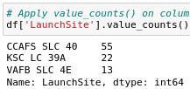
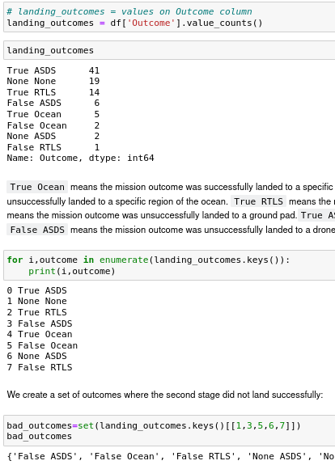
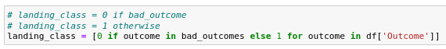
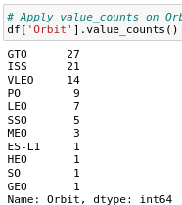
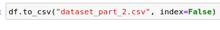
Data Wrangling
Calculate the number of launches on each site
Calculate the number and occurence of mission outcome per orbit type
Create a landing outcome label from Outcome column
Calculate the number and occurrence of each orbit
Save file:
9
Github URL: https://github.com/rafapaz/ML_IBM-10/blob/master/labs-jupyter-spacex-Data%20wrangling.ipynb

Slide 11
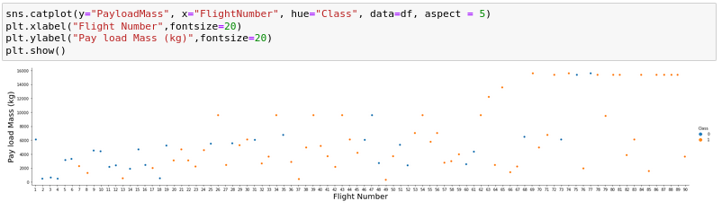
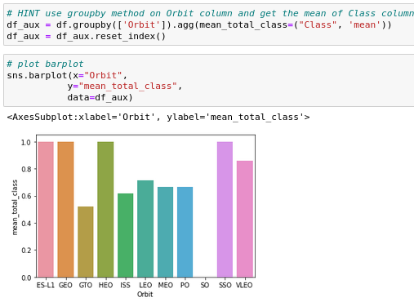
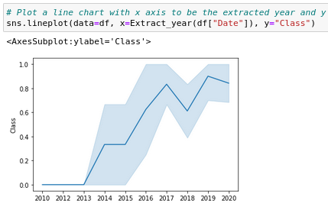
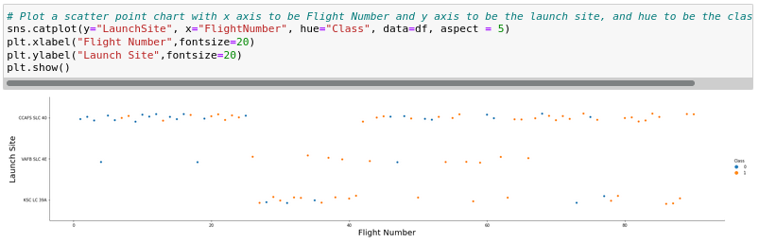
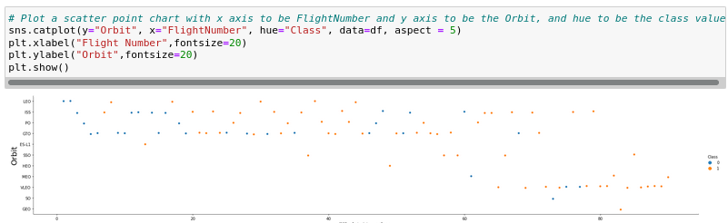
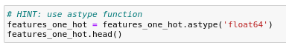
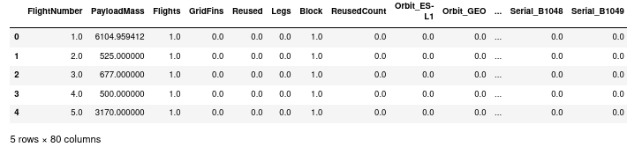
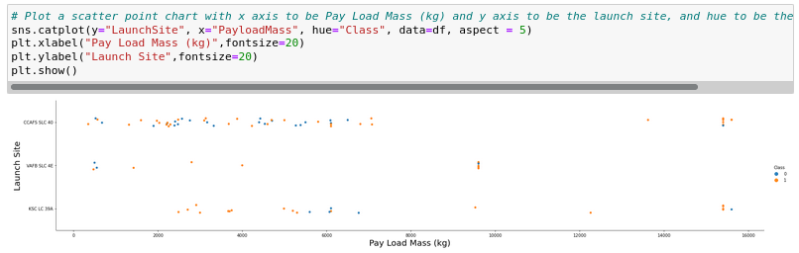
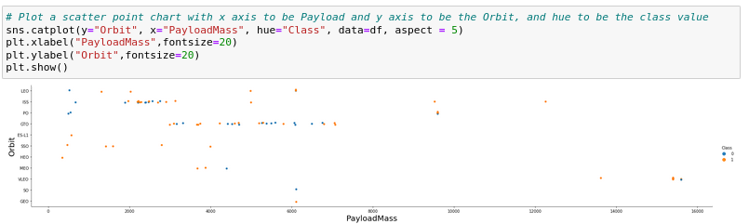
EDA with Data Visualization
Flight Number x Pay Load Mass
Relationship between success rate of each orbit type
Launch success yearly trend
Flight Number x Launch Site
Create dummy variables to categorical columns
FlightNumber x Orbit type
Launch Site x Pay Load Mass
Payload x Orbit type
10
Github URL: https://github.com/rafapaz/ML_IBM-10/blob/master/jupyter-labs-eda-dataviz.ipynb

Slide 12
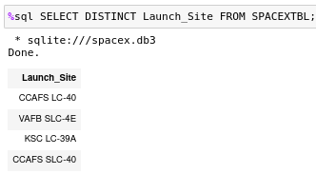
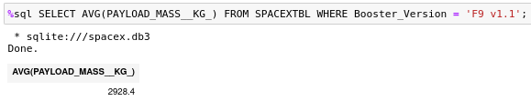
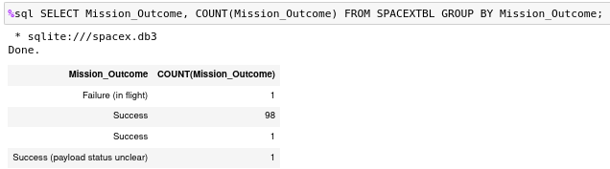
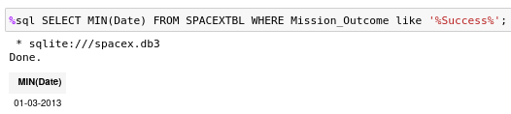
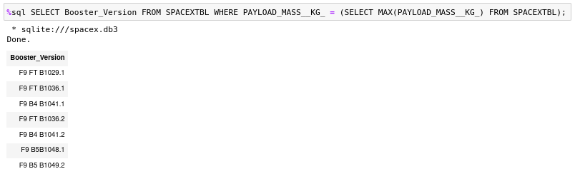
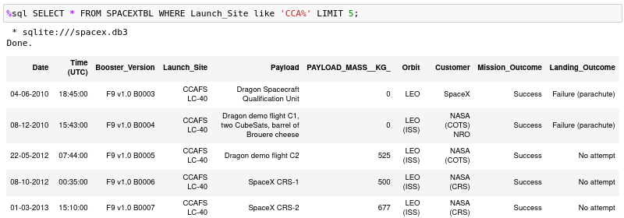
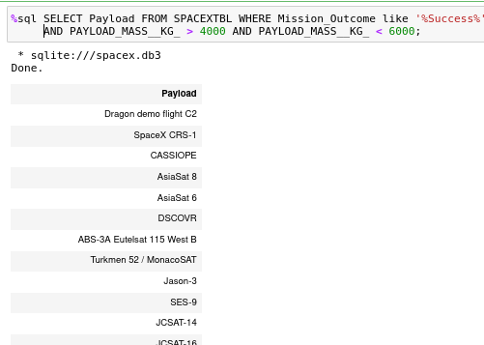
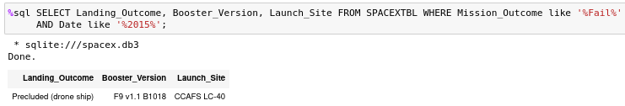
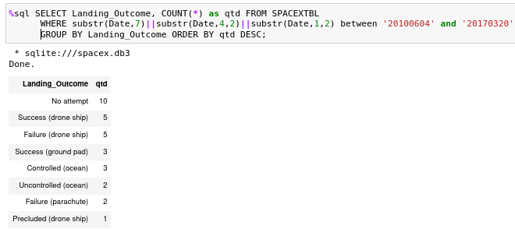
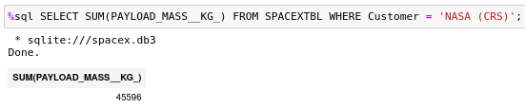
EDA with SQL
I imported the csv file into a SQLite database instead of using DB2.
11
Github URL: https://github.com/rafapaz/ML_IBM-10/blob/master/jupyter-labs-eda-sql-coursera.ipynb

Slide 13
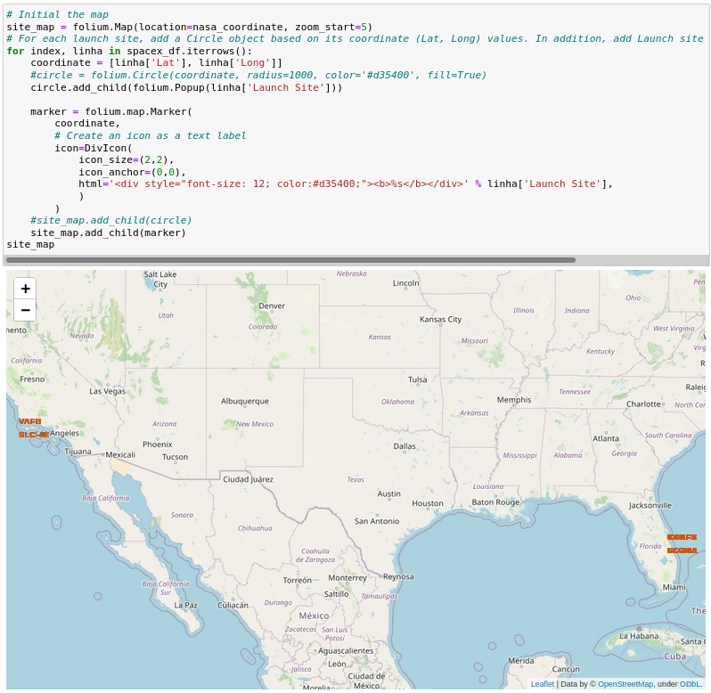
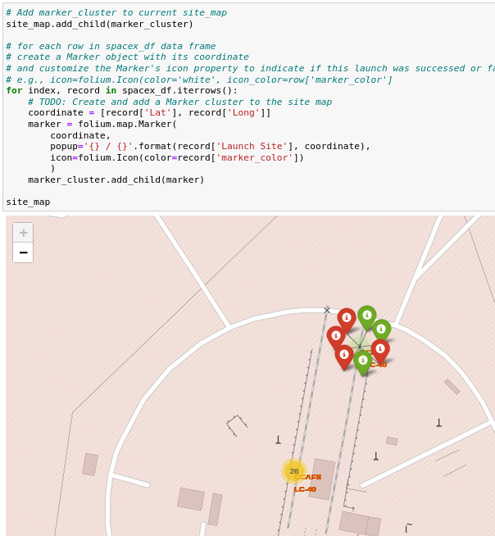
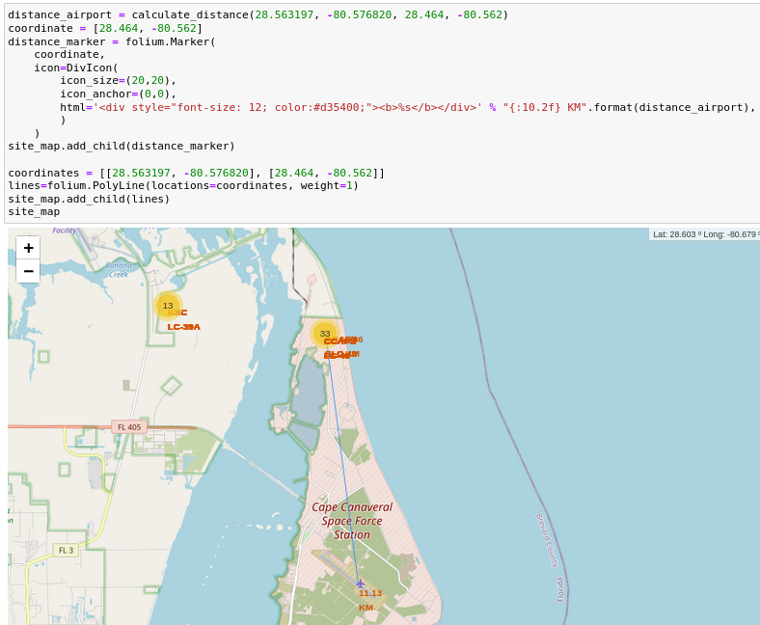
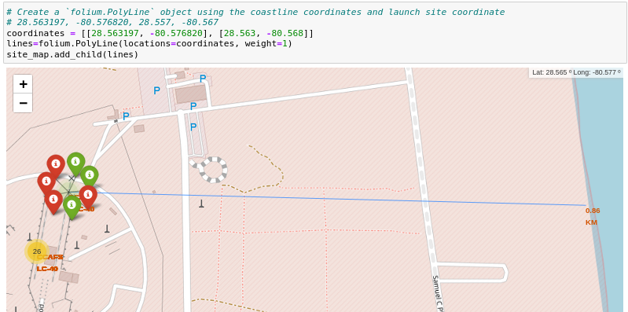
Build an Interactive Map with Folium
12
Github URL: https://github.com/rafapaz/ML_IBM-10/blob/master/lab_jupyter_launch_site_location.ipynb

Slide 14
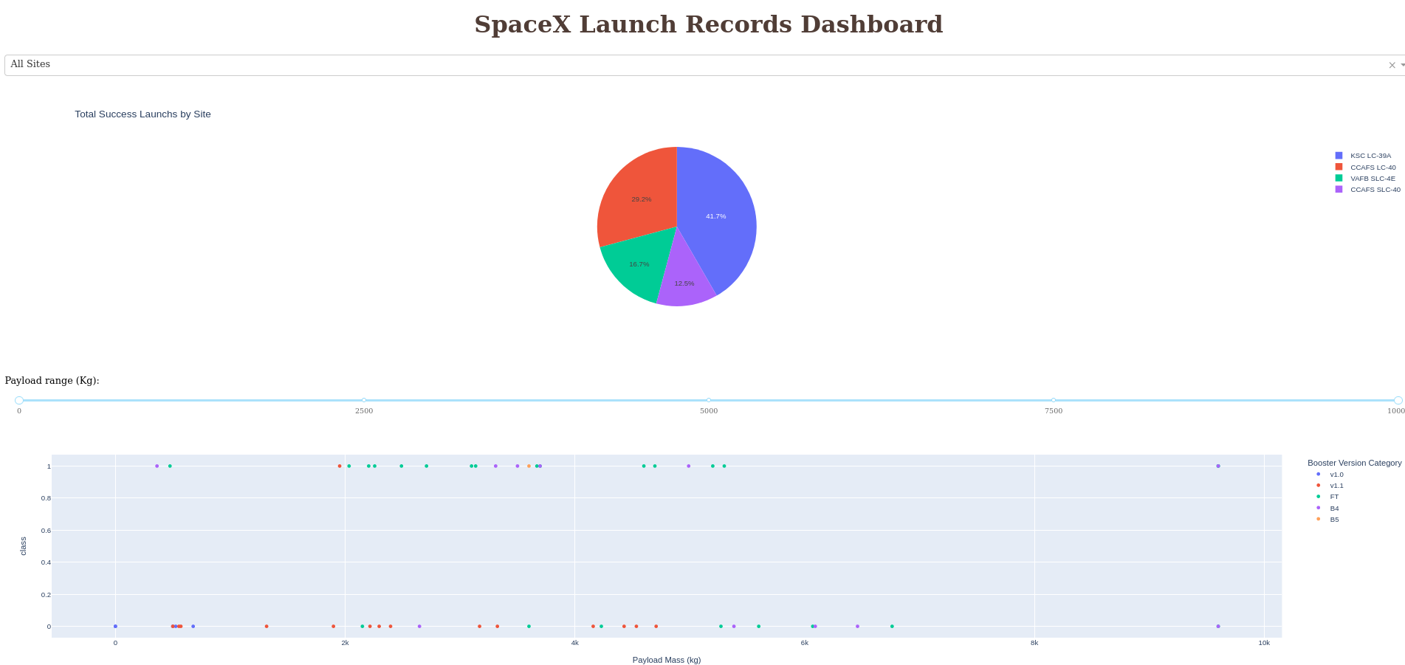
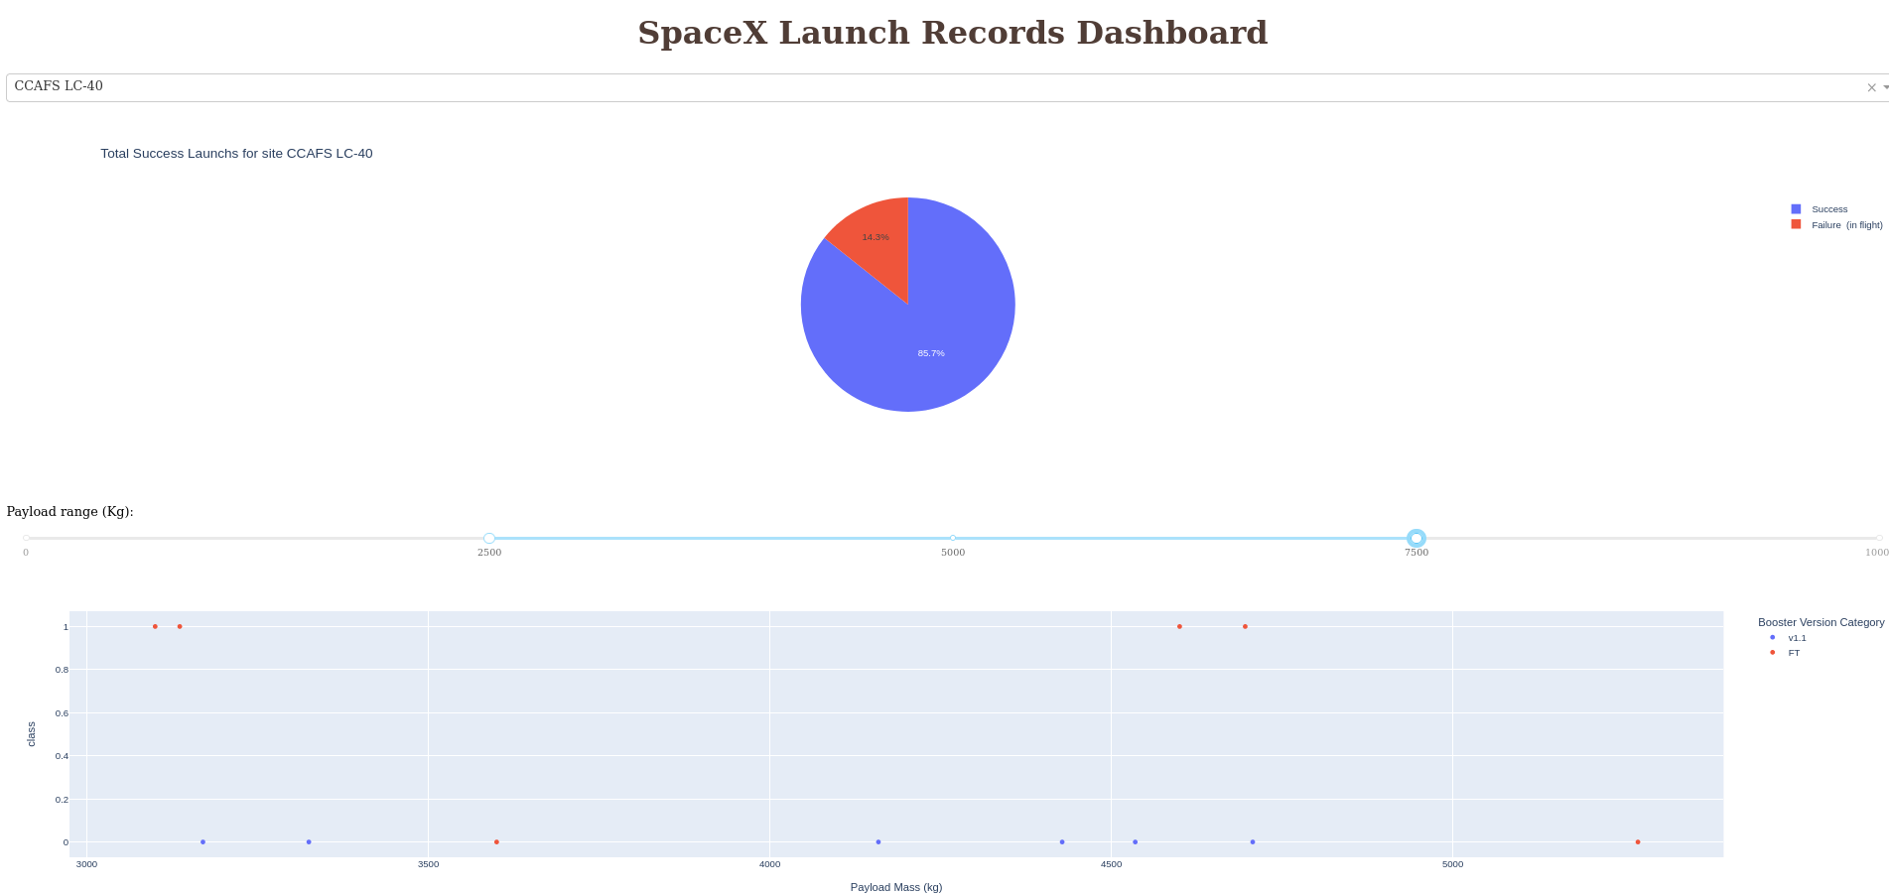
Build a Dashboard with Plotly Dash
Which site has the largest successful launches?
CCAFS LC-40
Which site has the highest launch success rate?
KSC LC-39A
Which payload range(s) has the highest launch success rate?
Between 2k and 4k
Which payload range(s) has the lowest launch success rate?
Between 6k and 10k
Which F9 Booster version (v1.0, v1.1, FT, B4, B5, etc.)
has the highest launch success rate?
FT
13
Github URL: https://github.com/rafapaz/ML_IBM-10/blob/master/spacex_dash_app.py

Slide 15
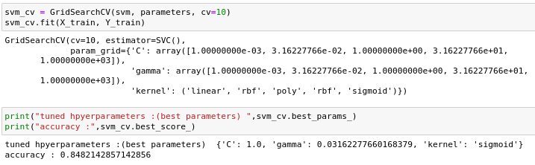
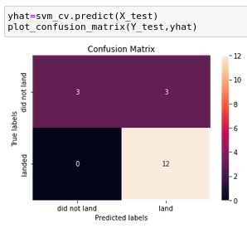
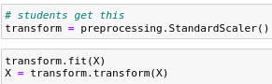
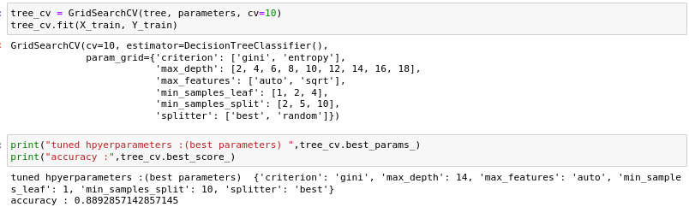
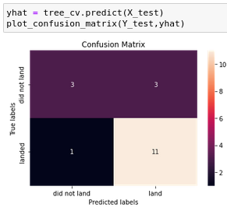
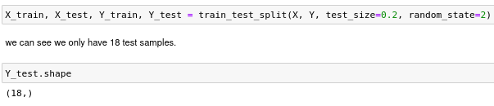
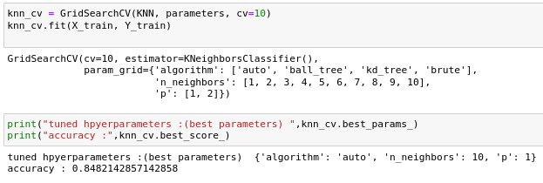
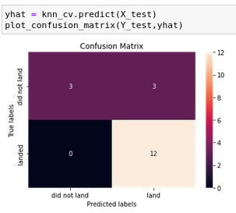
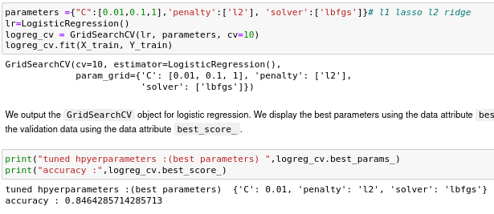
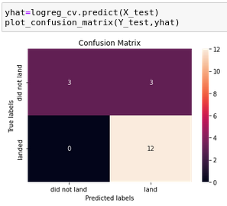
Predictive Analysis (Classification)
1 - Standardizing the data
2 - Split data in train and test
3 - Apply Logistic Regression
4 - Apply SVM
5 - Apply Decision Tree
6 - Apply K Neighboor
4
1
5
2
6
14
3
Github URL: https://github.com/rafapaz/ML_IBM-10/blob/master/SpaceX_Machine%20Learning%20Prediction_Part_5.ipynb

Slide 16
Results
Exploratory data analysis results
Interactive analytics demo in screenshots
Predictive analysis results
16
Notes:
<number>

Slide 17


Slide 18
Flight Number vs. Launch Site
The more amount of flights at a launch site the greater the
success rate at a launch site.
16

Slide 19
Payload vs. Launch Site
The greater the payload mass for Launch Site CCAFS SLC 40 the higher the success rate for the Rocket.
There is not quite a clear pattern to be found using this visualization to make a decision if the Launch Site is
dependant on Pay Load Mass for a success launch.
18

Slide 20
Success Rate vs. Orbit Type
Orbit GEO,HEO,SSO,ES-L1 has the best Success
Rate
19

Slide 21
Flight Number vs. Orbit Type
You should see that in the LEO orbit the Success appears related to the number of flights; on the other hand, there seems to be no relationship between flight number when in GTO orbit.
20

Slide 22
Payload vs. Orbit Type
You should observe that Heavy
payloads have a negative influence
on GTO orbits and positive on GTO
and Polar LEO (ISS) orbits.
21

Slide 23
Launch Success Yearly Trend
you can observe that the success rate since 2013 kept increasing till 2020
22

Slide 24
All Launch Site Names
Using the word DISTINCT in the query means that it will only
show Unique values in the Launch_Site column from tblSpaceX
23

Slide 25
Launch Site Names Begin with 'CCA'
Using the word LIMIT 5 in the query means that it will only show 5 records from tblSpaceX and LIKE keyword has a wild card with the words ‘CCA%’ the percentage in the end suggests that the Launch_Site name must start with CCA.
24

Slide 26
Total Payload Mass
Using the function SUM summates the total in the column
PAYLOAD_MASS_KG_
The WHERE clause filters the dataset to only perform
calculations on Customer NASA (CRS)
25

Slide 27
Average Payload Mass by F9 v1.1
Using the function AVG works out the average in the column
PAYLOAD_MASS_KG_
The WHERE clause filters the dataset to only perform
calculations on Booster_version F9 v1.1
26

Slide 28
First Successful Ground Landing Date
Using the function MIN works out the minimum date in the
column Date
The WHERE clause filters the dataset to only perform
calculations on Mission_Outcome Success (drone ship)
27

Slide 29
Successful Drone Ship Landing with Payload between 4000 and 6000
Selecting only Booster_Version
The WHERE clause filters the dataset to Landing_Outcome =
Success (drone ship)
The AND clause specifies additional filter conditions
Payload_MASS_KG_ > 4000 AND Payload_MASS_KG_ < 6000
28

Slide 30
Total Number of Successful and Failure Mission Outcomes
Here we use GROUP BY clause to group the unique Mission_Outcome and its count with COUNT clause
29

Slide 31
Boosters Carried Maximum Payload
Here we use subquery to get the maximum Payload and the clause WHERE to filter only Booster version that has Payload equal the maximum.
30

Slide 32
2015 Launch Records
Here we use the % symbol to filter Mission Outcomes that has failed and happens in 2015 year.
31

Slide 33
Rank Landing Outcomes Between 2010-06-04 and 2017-03-20
Here we use GROUP BY to group unique Landing_Outcome and COUNT to count its records. We use substr function to facilitate filter date as string.
32

Slide 34


Slide 35
All launch sites global map markers
33
We can see that the SpaceX launch sites are in the United States of America coasts.
Florida and California

Slide 36
Colour Labelled Markers
Green Marker shows successful Launches and Red Marker
shows Failures
35

Slide 37
Launch Sites distance to the nearest airport
36

Slide 38


Slide 39
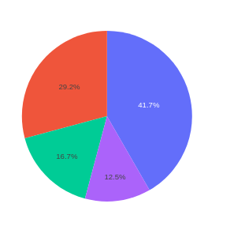

DASHBOARD – Pie chart showing the success percentage achieved by each launch site
We can see that KSC LC-39A had the
most successful launches from all the sites
37

Slide 40

Pie chart for the launch site with highest
launch success ratio
KSC LC-39A achieved a 76.9% success rate while getting a 23.1% failure rate
39

Slide 41


Payload vs. Launch Outcome scatter plot for all Sites, with different payload selected screenshot in the range slider
Low Weighted Payload 0kg – 2500kg
Heavy Weighted Payload 2500kg – 10000kg
40

Slide 42


Slide 43

Classification Accuracy
The Logistic Regression, SVM and KNN algorithms had the same value for the score with test data.
41

Slide 44
Confusion Matrix
Examining the confusion matrix, we see that there was few false positives.
43

Slide 45
Conclusions
There was a tie between the Logistic Regression, SVM and KNN algorithms.
Low weighted payloads perform better than the heavier payloads
The success rates for SpaceX launches is directly proportional time in years they will eventually perfect the launches
We can see that KSC LC-39A had the most successful launches from all the sites
Orbit GEO,HEO,SSO,ES-L1 has the best Success Rate
44

Slide 46
Appendix
I created a SQLite database to do the SQL queries. I imported de csv file to that database.
45
Notes:
<number>

Slide 47


